Slide 1
Tableau Assignment
A
Project Report On
"Video Game Sales“
SUBMITTED BY
Abhay Chauhan

Slide 2
Contents
SR.NO | CHAPTER NAME | PAGE NO.
01. | INTRODUCTION | 3
02. | SOURCE OF THE DATA | 4
03. | OUTCOME OF THE ANALYIS | 5-6
04. | CONCLUSION | 7
2

Slide 3
INTRODUCTION
The main objective of the project is to design a dynamic, responsive dashboard with fully fledge logic and environment using various charts to make them visually beautiful, with various sets of filters and colour dimension.
3

Slide 4
SOURCE OF DATA
The data I have used in this project is from Kaggle. The data name is "Video Game Sales” which has 700 rows and 12 columns. The columns which I have used the most for my project are:
1. Genre.
2. Publisher.
3. Name.
4. North America Sales.
5. Europe Sales.
6. Japan Sales.
7. Global Sales.
OUTCOME
4

Slide 5
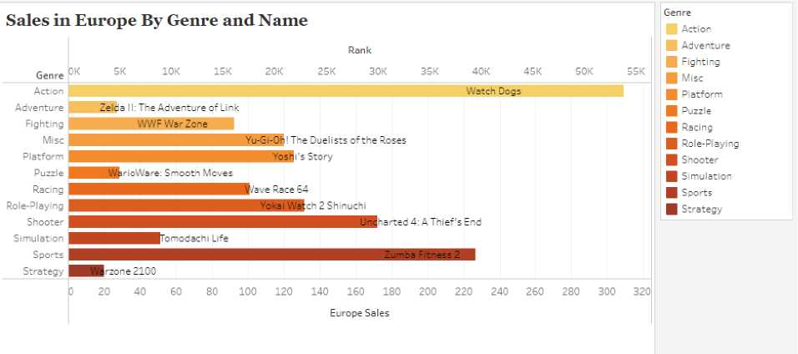
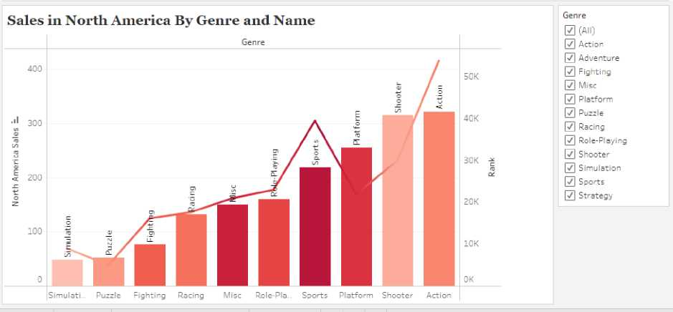
OUTCOME OF THE ANALYSIS
• The first analysis is for the Europe Sales, over where I have used the Europe Sales Column, Rank Columns, and the Genre Column. And the result of Europe Sales and Rank is done based on their Genre. A vertical bar chart is used over here to represent the total amount of sales in Europe based on their genre.
• The second analysis is for the North America Sales, over where I have used the North America Column, Name Column, Rank Column, and the Genre Column. A horizontal
5

Slide 6
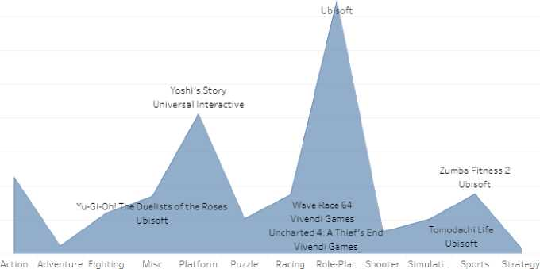
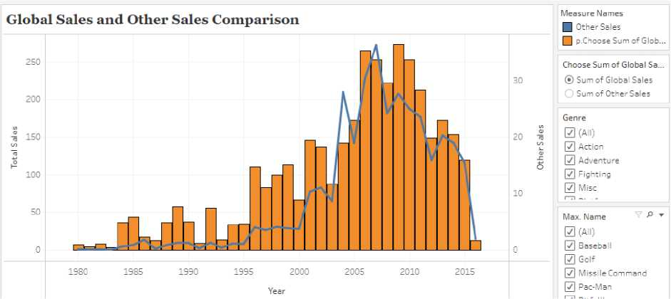
bar chart is used to represent the total sales in each genre with the line chart is used over to represent the rank of different genres.
Sales in Japan By Genre and Names
Genre
YokBi Watch 2 Shinuchi
• The third analysis is for the Japan Sales, Over where I have used the Japan Sales Column, Publisher column, Genre Column, and Name Column. A scatter plot is used over here to represent the total sales concerning the publisher's name and genre.
• The fourth analysis is for the Global Sales and Other Sales, over where I have used the Global Sales Column, Other Sales Column, Genre Column, and Name Column. A dual-axis chart
6

Slide 7
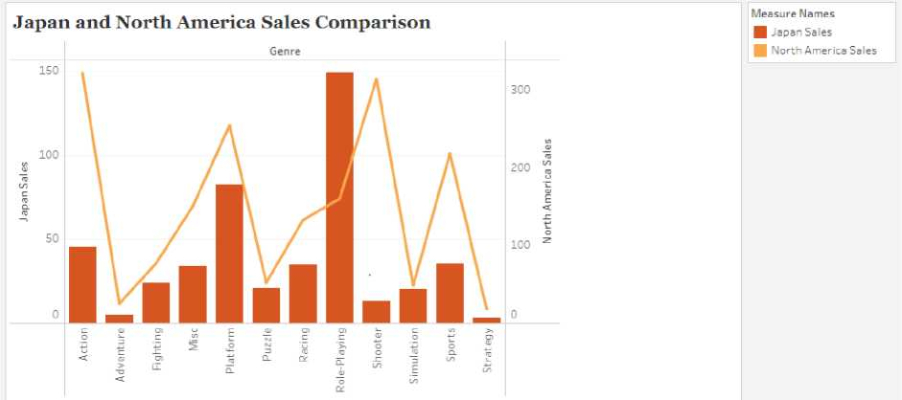
is used over here to represent both the Global Sales and Other Sales. A horizontal bar chart is used to represent the Global Sales Column, while a Line chart is used to represent the Other Sales Column. A parameter is used over here to represent both the Sales Column.
• The fifth and the last analysis is for the comparison of Japan Sales and North America Sales based on Genre and Name. Both a bar chart and line chart are used to represent Japan Sales and North America Sales.
7

Slide 8
CONCULSION
Here, I have come to the end of my detailed analysis of my project.
I tried my best to include all the necessary points that are related to the given assignment on Tableau. This project contains information on the various charts analysis where each of the five explains the total sales in the specific region. Also, a proper dashboard has been maintained containing all the charts represented in the proper format. With, Filters and Title Provided in it.
I do hope that my project will be insightful and look visually impairing.
*I have prepared the dashboard on Tableau Online So, I will be sharing the online credentials, where you can access my dashboard presentation.
Edit | Abhay Assignment (tableau.com)
Email id - Abhay@ansrpo.com Password -Abhay#5025
8

